Slide 1
Software Engineering (ESC501) - Project Planning & Project Estimation Techniques
- Prof. Poulami Dutta

Slide 2
Intended Learning Outcomes (ILOs)
Identify the job responsibilities of a software project manager.
Identify the necessary skills required in order to perform software project management.
Identify the essential activities of project planning.
Determine the different project related estimates performed by a project manager and suitably order those estimates.
Explain what is meant by Sliding Window Planning.
Explain what is Software Project Management Plan (SPMP).
Identify and explain two metrics for software project size estimation.
Identify the shortcomings of function point (FP) metric.

Slide 3
Organization of this Lecture
Introduction to Project Planning
Software Cost Estimation
Cost Estimation Models
Software Size Metrics
Empirical Estimation
Heuristic Estimation
COCOMO
Staffing Level Estimation
Effect of Schedule Compression on Cost
Summary

Slide 4
Introduction
Many software projects fail:
due to faulty project management practices:
It is important to learn different aspects of software project management.
Goal of software project management:
enable a group of engineers to work efficiently towards successful completion of a software project.

Slide 5
Responsibility of Project Managers
take the overall responsibility of steering a project to success.
difficult to objectively describe the job responsibilities of a project manager.
ranges from invisible activities like building up team morale to highly visible customer presentations.
activities can be broadly classified into
project planning - project planning activity is undertaken before the development starts to plan the activities to be undertaken during development.
project monitoring and
control activities – undertaken once the development activities start with the aim of ensuring that the development proceeds as per plan and changing the plan whenever required to cope up with the situation.

Slide 6
Responsibility of Project Managers (Contd.)
Project proposal writing,
Project cost estimation,
Scheduling,
Project staffing,
Project monitoring and control,
Software configuration management,
Risk management,
Managerial report writing and presentations, etc.

Slide 7
Skills for Software Project Management
theoretical knowledge,
good qualitative judgment and decision making capabilities,
good grasp of the latest software project management techniques such as cost estimation, risk management, configuration management,
good communication skills and the ability to get work done,
skills such as tracking and controlling the progress of the project, customer interaction, managerial presentations, and team building are largely acquired through experience.

Slide 8
Project Planning Activities
Estimation:
Project size: What will be problem complexity in terms of the effort and time required to develop the product? Cost: How much is it going to cost to develop the project? Duration: How long is it going to take to complete development? Effort: How much effort would be required?
Project scheduling of man power and other resources.
Staff organization:
staffing plans
Risk handling:
identification, analysis, and abatement procedures.
Miscellaneous plans: quality assurance plan, configuration management plan, etc.

Slide 9
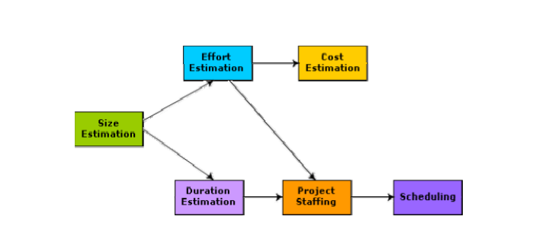
Precedence of Project Planning Activities

Slide 10
Sliding Window Planning
Requires utmost care and attention since commitment to unrealistic time and resource estimates result in schedule slippage.
Delays can cause customer dissatisfaction and adversely affect team morale. It can even cause project failure.
For large projects, it is very much difficult to make accurate plans. A part of this difficulty is due to the fact that the proper parameters, scope of the project, project staff, etc. may change during the span of the project.
To overcome this problem, sometimes project managers undertake project planning in stages.
Protects from making commitments too early.
Technique of staggered planning is known as Sliding Window Planning
Starts with an initial plan,
Project is planned accurately in the successive stages,
After the completion of every phase, the project managers can plan each subsequent phase more accurately and with increasing levels of confidence.
s

Slide 11
SPMP (Software Project Management Plan)
After planning is complete:
Document the plans:
in a Software Project Management Plan(SPMP) document.
List of different items.
SPMP

Slide 12
Organization of SPMP Document
Introduction (Objectives, Major Functions, Performance Issues, Management and Technical Constraints)
Project Estimates (Historical Data, Estimation Techniques, Effort, Cost, and Project Duration Estimates)
Project Resources Plan (People, Hardware and Software, Special Resources)
Schedules (Work Breakdown Structure, Task Network, Gantt Chart Representation, PERT Chart Representation)
Staff Organization (Team Structure, Management Reporting)
Risk Management Plan (Risk Analysis, Risk Identification, Risk Estimation, Abatement Procedures)
Project Tracking and Control Plan
Miscellaneous Plans (Process Tailoring, Quality Assurance)

Slide 13
Metrics For Software Project Size Estimation
size of a problem is obviously not the number of bytes that the source code occupies
neither is it the byte size of the executable code
project size is a measure of the problem complexity in terms of the effort and time required to develop the product
Currently two metrics are popularly being used widely to estimate size:
lines of code (LOC) and
function point (FP)

Slide 14
Software Size Metrics
LOC (Lines of Code):
Simplest and most widely used metric.
Comments and blank lines should not be counted.
project size is estimated by counting the number of source instructions in the developed program.
accurate estimation of the LOC count at the beginning of a project is very difficult.
project managers usually divide the problem into modules, and each module into submodules and so on, until the sizes of the different leaf-level modules can be approximately predicted.
using the estimation of the lowest level modules, project managers arrive at the total size estimation.

Slide 15
Disadvantages of Using LOC
Size can vary with coding style.
Focuses on coding activity alone.
Correlates poorly with quality and efficiency of code.
Penalizes higher level programming languages, code reuse, etc.
Measures lexical/textual complexity only.
does not address the issues of structural or logical complexity.
Difficult to estimate LOC from problem description.
So not useful for project planning.

Slide 16
Function Point Metrics
Function point metric (FP) was first proposed by Albrecht in early 80's.
FP can be used to:
Estimate the cost of effort required to design, code and test the software,
Predict the number of errors that will be encountered during testing,
Forecast the number of components and/or the number of projected source lines.
FPs are derived using an empirical relationship based on countable measures of software’s information domain and assessment of its quality.

Slide 17
Function Point Metric – Information Domain Values (IDVs)
Number of External Inputs (EIs):
A set of related inputs is counted as one input.
It originates from a user or is transmitted from another application.
Number of External Outputs (EOs):
A set of related outputs is counted as one output.
It is derived within the application and provides information to the user.
It refers to reports, screens, error messages etc.
Number of External Inquiries (EQs):
Each user query type is counted.
Number of Internal Logical Files (ILFs):
Files are logically related data and thus can be data structures or physical files.
It resides within the application’s boundary.
Number of External Interface Files (EIFs):
Data transfer to other systems.
Resides external to the application.

Slide 18
Function Point Metric (Contd.)
Computing Function Points
Once the data have been collected, the following table is computed and a complexity value is associated with each count.
Organizations develop a criteria for determining whether a particular entry is simple, average or complex.
IDV | COUNT | X | SIMPLE | AVERAGE | COMPLEX | =
EIs |  |  | 3 | 4 | 6
EOs |  |  | 4 | 5 | 7
EQs |  |  | 3 | 4 | 6
ILFs |  |  | 7 | 10 | 15
EIFs |  |  | 5 | 7 | 10
Count Total

Slide 19

Function Point Metric (Contd.)
Computing Function Points
FP = Count Total x [0.65 + 0.01 x $Σ (Fi)]$, constants/weighing factors are empirically determined.

Slide 20
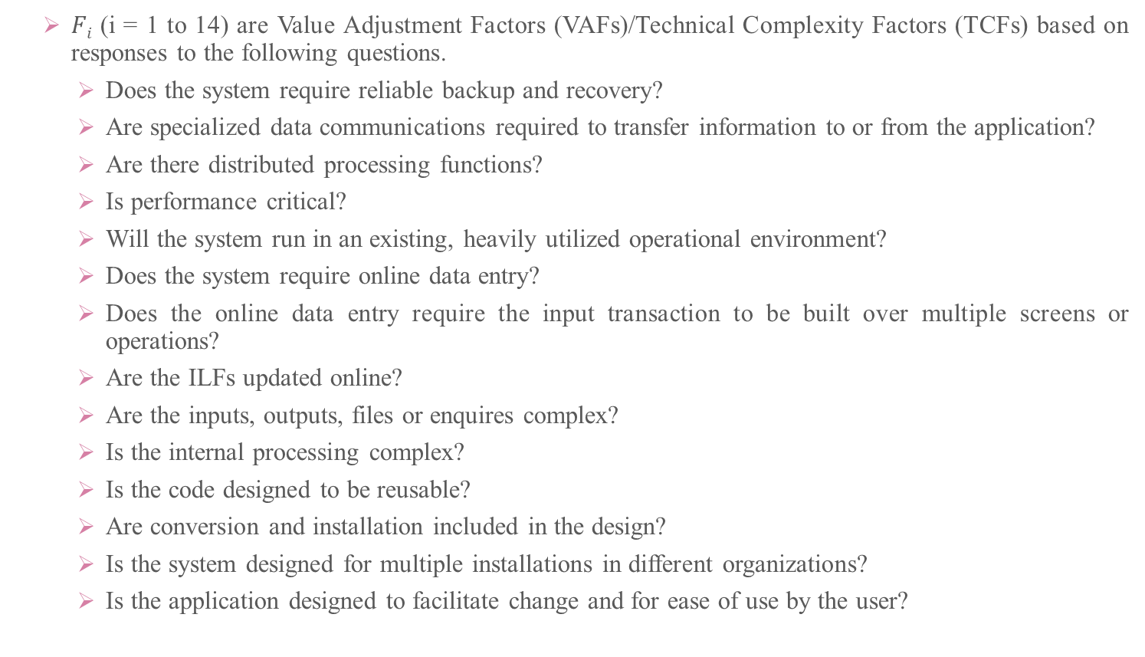
Function Point Metric (Contd.)
$Fi$ (i = 1 to 14) are Value Adjustment Factors (VAFs)/Technical Complexity Factors (TCFs) based on responses to the following questions.
Does the system require reliable backup and recovery?
Are specialized data communications required to transfer information to or from the application?
Are there distributed processing functions?
Is performance critical?
Will the system run in an existing, heavily utilized operational environment?
Does the system require online data entry?
Does the online data entry require the input transaction to be built over multiple screens or operations?
Are the ILFs updated online?
Are the inputs, outputs, files or enquires complex?
Is the internal processing complex?
Is the code designed to be reusable?
Are conversion and installation included in the design?
Is the system designed for multiple installations in different organizations?
Is the application designed to facilitate change and for ease of use by the user?

Slide 21
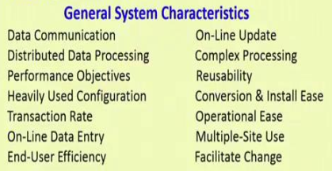
VAFs/TCFs

Slide 22
Function Point Metric (Contd.)
Degrees of Influence for VAFs/TCFs
Each of these questions is answered using a scale that ranges from 0 – 5
0 – No Influence
1 – Incidental
2 – Moderate
3 – Average
4 – Significant
5 - Essential

Slide 23
Case Study I: Safe Home Software
The function manages user interaction, accepting a user password to activate or deactivate the system and allows inquires on the status of security zones and various security sensors.
The function displays a series of prompting messages and sends appropriate control signals to various components of the security system.

Slide 24
Case Study I: Safe Home Software
Sensors
Test Sensor
Password
Zone Setting
User
Safe Home or Interaction Function
Zone Inquiry
Messages
User
Sensor Inquiry
Sensor status
Panic Button
Activate/Deactivate
Activate/Deactivate
Monitoring & Response Sub-System
Password, sensors, ……..
Alarm Alert
System Configuration Data

Slide 25
Case Study I: Safe Home Software (Computing FP)
Function__Point__Metric__Safe__Home__Software.xls

Slide 26
Case Study II: Spell Checker Software
The spell-checker accepts as input, a document file and an optional personal directory file.
Then the spell checker lists all words which are not contained in either of these files.
The user can query the number of words processed and the number of spelling errors which are found at any stage during the processing.

Slide 27
Case Study II: Spell Checker Software
Document File
#words processed message
User
User
Personal Directory File
Spell Checker or Interaction Function
#errors message
Errors found Inquiry
Misspelt words report
Word process Inquiry
System Configuration Data

Slide 28
Case Study II: Spell Checker Software (Computing FP)
Function__Point__Metric__Spell__Checker__Software.xls

Slide 29
Function Point Metric (CONT.)
Suffers from a major drawback:
the size of a function is considered to be independent of its complexity.
Extend function point metric:
Feature Point metric:
considers an extra parameter:
Algorithm Complexity.

Slide 30
Function Point Metric (CONT.)
Proponents claim:
FP is language independent.
Size can be easily derived from problem description.
Opponents claim:
it is subjective --- Different people can come up with different estimates for the same problem.

Slide 31
Case Study III: Mobile Application (Class Assignment)
The activity has been designed and developed specifically to run on tablet computers for teaching autistic children.
They are very important visual support systems for the autistic children to develop skills like getting organized, acting independently and making selections.

Slide 32
Case Study IV: Payroll Application
Transaction to input, amend and delete employee details.
Transaction to calculate pay details from timesheet data.
Transaction to print pay-to-date details for each employee.
A file of payroll details for each employee.
A personnel file maintained by another system that is accessed for name and address details.

Slide 33


